Slide 1
Time Series
Yr12 Applications unit 4

Slide 2
Contents (Mr Morgan added hyperlinks for your convenience)
Lesson 1: Time Series Data
Lesson 2: Describing Time Series Data
Lesson 3: Moving Averages
Lesson 4: Centered Moving Averages
Lesson 5: Seasonal Indices
Lesson 6: Deseasonalising Data

Slide 3
Overarching Syllabus points
4.1.8 implement the statistical investigation process to answer questions that involve the analysis of time series data
This point is covered in learning activities throughout lessons.

Slide 4
Lesson 1
Back to Contents
Topic: Time Series Data
EQ: What is time series data and how do I graph it?
Syllabus points:
4.1.1 construct time series plots
4.1.6 fit a least-squares line to model long-term trends in time series data
4.1.7 predict from regression lines, making seasonal adjustments for periodic data

Slide 5
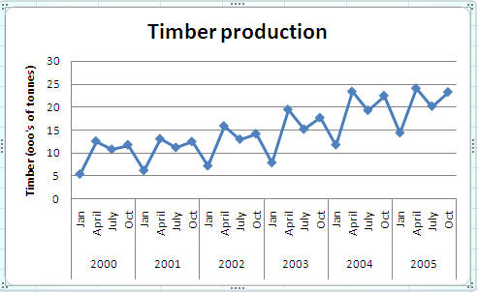
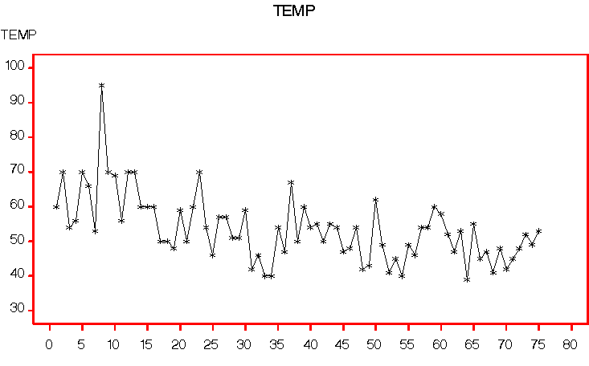
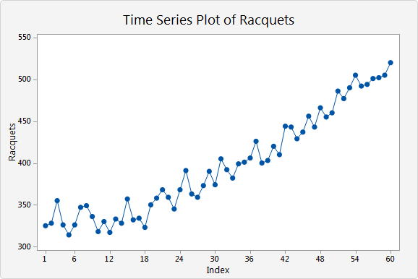
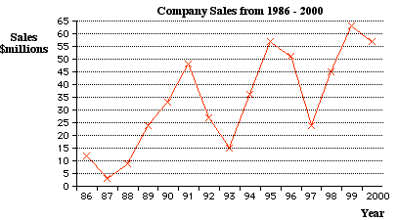
Topic: Time series data
EQ: What is time series data and how do I graph it?

Slide 6
Topic: Time series data
EQ: What is time series data and how do I graph it?
Time series data describes how the value of a variable changes over time.
The data is presented in a table:
Eg/ Number of customers in a city restaurant at hourly intervals
Time | 10am | 11am | 12pm | 1pm | 2pm | 3pm | 4pm | 5pm | 6pm | 7pm | 8pm
No. Customers | 12 | 22 | 20 | 29 | 25 | 16 | 10 | 13 | 27 | 35 | 20
To graph time series data we plot each data point and then join them with straight line segments.
Time is always plotted on the horizontal axis

Slide 7
Topic: Time series data
EQ: What is time series data and how do I graph it?
Make sure:
You label the axis
Have a consistent scale for both axis
Join adjacent points

Slide 8
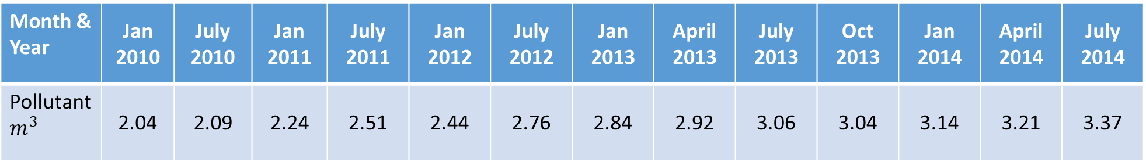
Topic: Time series data
EQ: What is time series data and how do I graph it?
Sometimes the given data doesn’t have a consistent time scale:
Month & Year | Jan 2010 | July 2010 | Jan 2011 | July 2011 | Jan 2012 | July 2012 | Jan 2013 | April 2013 | July 2013 | Oct 2013 | Jan 2014 | April 2014 | July 2014
Pollutant $m^{3}$ | 2.04 | 2.09 | 2.24 | 2.51 | 2.44 | 2.76 | 2.84 | 2.92 | 3.06 | 3.04 | 3.14 | 3.21 | 3.37
The time scale still needs to be consistent

Slide 9
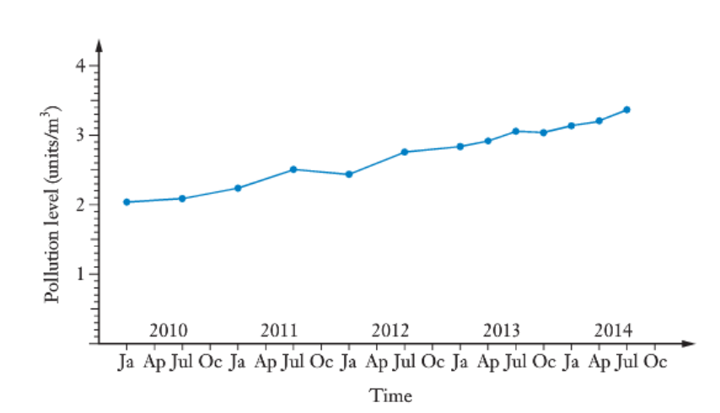
Topic: Time series data
EQ: What is time series data and how do I graph it?
The problem is that the horizontal axis values can’t be entered in to the ClassPad for analysis

Slide 10
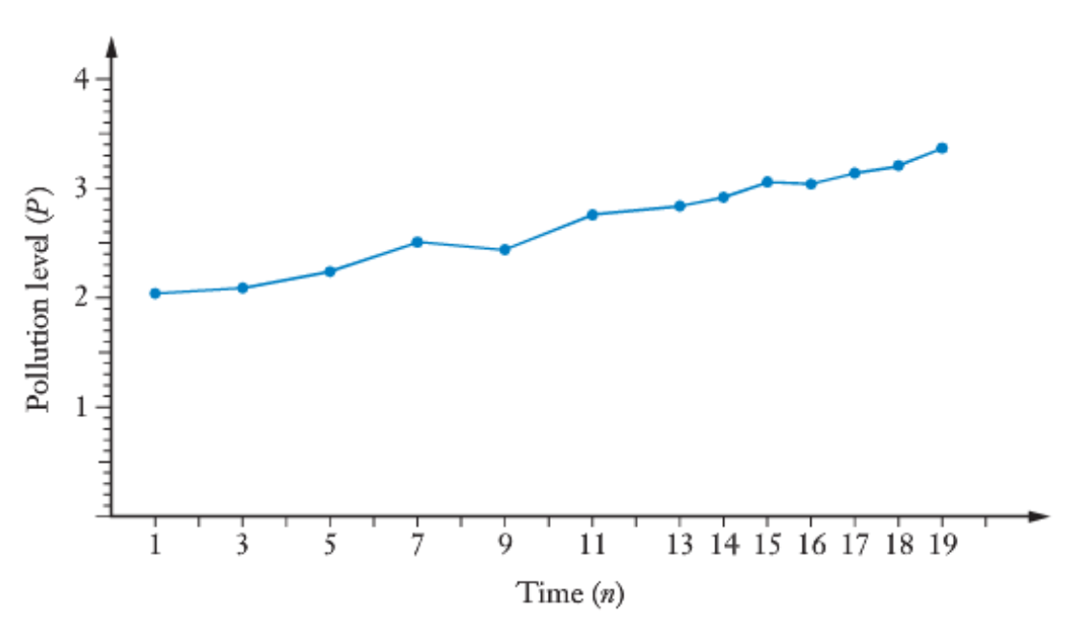
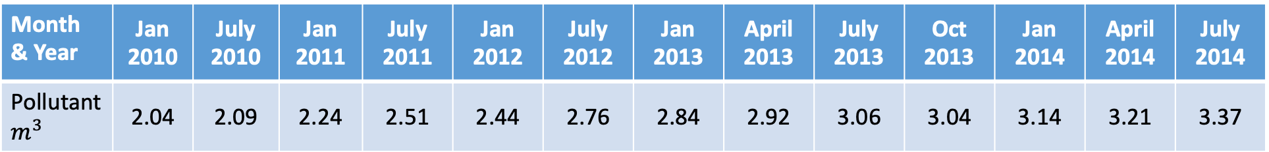
Month & Year | Jan 2010 | July 2010 | Jan 2011 | July 2011 | Jan 2012 | July 2012 | Jan 2013 | April 2013 | July 2013 | Oct 2013 | Jan 2014 | April 2014 | July 2014
Pollutant $m^{3}$ | 2.04 | 2.09 | 2.24 | 2.51 | 2.44 | 2.76 | 2.84 | 2.92 | 3.06 | 3.04 | 3.14 | 3.21 | 3.37
This is a bit tricky, as in 2010- 2012, the pollutants are measured twice a year, whereas in 2013-14, they are measured 4 times a year. We need to take care that the scale reflects this. One way we could display the data is:

Slide 11
Topic: Time series data
EQ: What is time series data and how do I graph it?
The table below shows Jana’s heart rate during a 60 minute gym session:
Time (minutes) | 0 | 5 | 10 | 15 | 20 | 25 | 30 | 35 | 40 | 45 | 50 | 55 | 60
Heart Rate (Beats per min) | 50 | 80 | 95 | 112 | 120 | 142 | 130 | 145 | 158 | 152 | 165 | 160 | 135
Draw the time series plot for this data.

Slide 12
Topic: Time series data
EQ: What is time series data and how do I graph it?
Time | Value (US cents)
9:00 9:30 10:00 10:30 11:00 11:30 12:00 12:30 13:00 13:30 14:00 14:30 15:00 15:30 16:00 16:30 17:00 | 76.8 76.5 76.1 76.6 76.2 76.0 75.5 75.9 76.2 75.8 76.4 75.7 75.4 76.1 76.5 75.8 76.0
The table on the right shows the value of AUD$ in US cents at various times over a day.
Draw the time series plot for this data.

Slide 13
Complete Exercise 1A
Back to Contents

Slide 14
Lesson 2
Back to Contents
Topic: Time Series Data
EQ: How do I describe time series graphs and data?
Syllabus points:
4.1.2 describe time series plots by identifying features such as trend (long term direction), seasonality (systematic, calendar-related movements), and irregular fluctuations (unsystematic, short term fluctuations), and recognise when there are outliers
4.1.6 fit a least-squares line to model long-term trends in time series data
4.1.7 predict from regression lines, making seasonal adjustments for periodic data

Slide 15
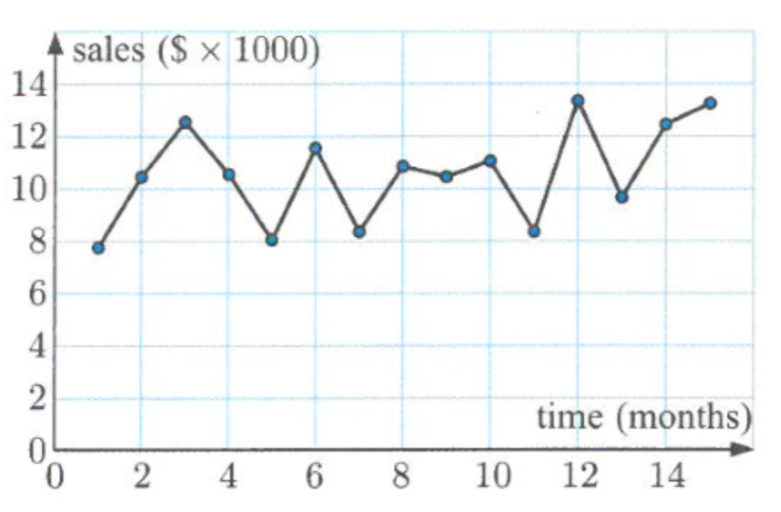
Topic: Time series data
EQ: How do I describe time series graphs/data?
Random Variation
Short term, unsystematic fluctuations in data, but overall the data is subject to random variation

Slide 16
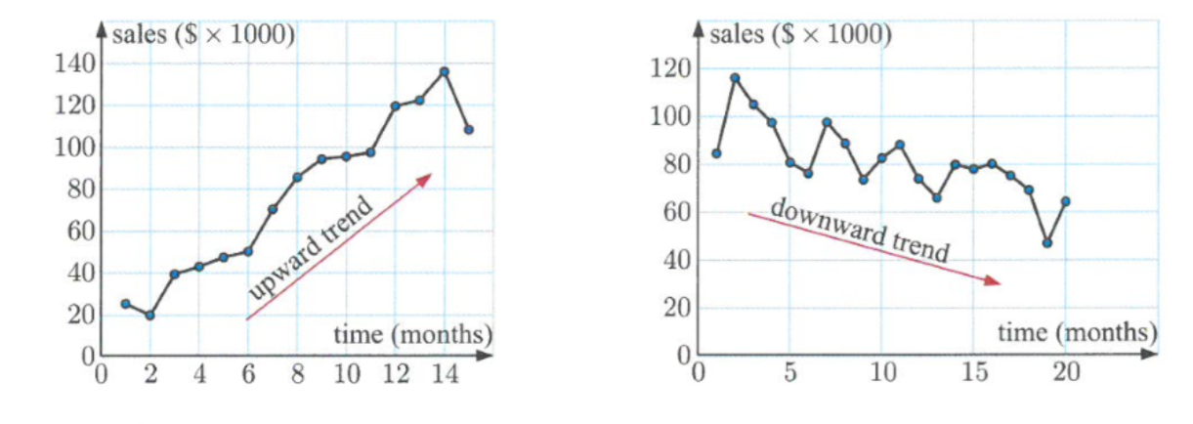
Topic: Time series data
EQ: How do I describe time series graphs/data?
Upward & Downward Trends

Slide 17
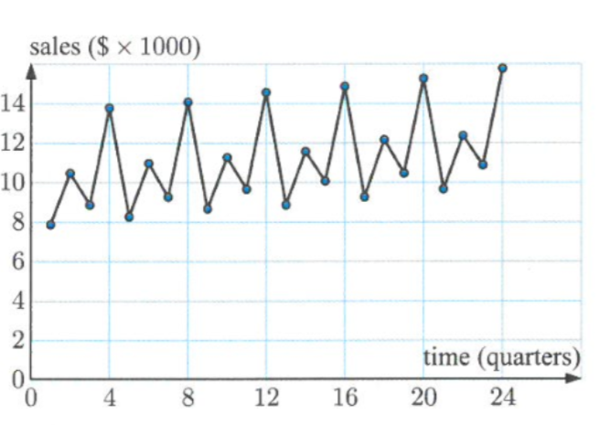
Topic: Time series data
EQ: How do I describe time series graphs/data?
Seasonal trends
Where a pattern is repeated a certain intervals

Slide 18
Complete Klup Exercise 1A
Back to Contents

Slide 19

Well done on completing chapter 1
Back to Contents

Slide 20
Lesson 3
Back to Contents
Topic: Moving Averages
EQ: What is a moving average and why do we use them?
Syllabus points:
4.1.3 smooth time series data by using a simple moving average, including the use of spreadsheets to implement this process

Slide 21
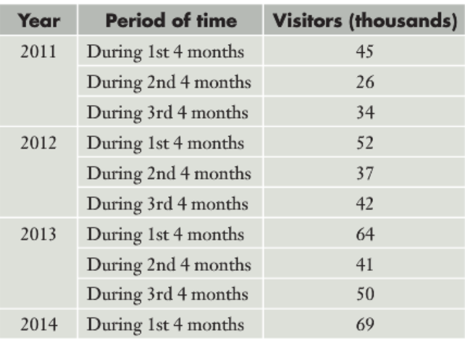
Topic: Moving Averages
EQ: What is a moving average and why do we use them?
Situation: The owners of a tourist attraction have asked you to analyze the below data to see if there are any trends they can exploit for the future.
Looking at the data as displayed, are there any trends that jump out at you?
In this chapter, you will learn tools that will help you better analyze this sort of fluctuating date, with the goal of:
making underlying trends more apparent
making predictions

Slide 22
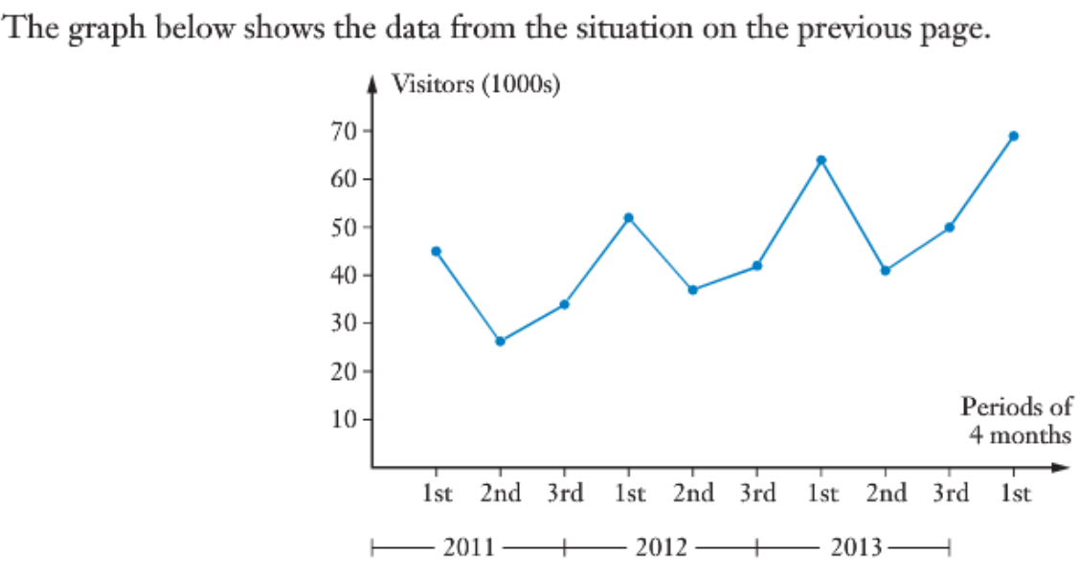
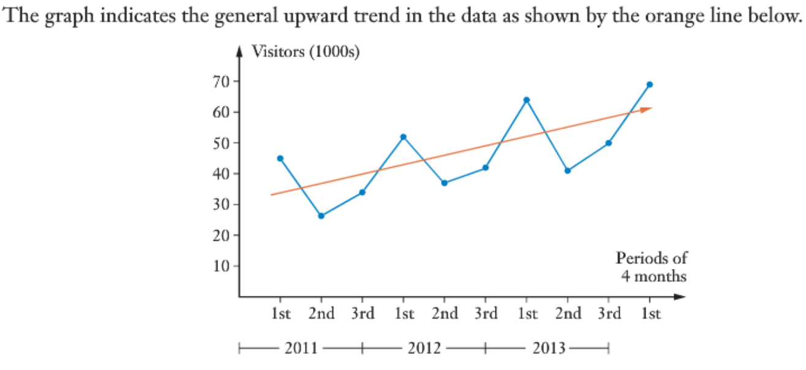
Topic: Moving Averages
EQ: What is a moving average and why do we use them?
This graph shows that the data is seasonal in nature, with three ‘seasons’ making up the cycle.
Seasonal variation has a constant time period/regular frequency. A repeating pattern without regular frequency is considered cyclical rather than seasonal.
The peaks occur at the 1st, 4th, 7th and 10th points, with troughs at the 2nd, 5th and 8th plotted points.
In the pas we have used a line of best fit (linear regression) to help us analyze the date, which would look like this:
When data is seasonal in nature, and spread out, it is better to first smooth the graph by attempting to remove the seasonal variation. to do this, we use a technique called the moving average.

Slide 23
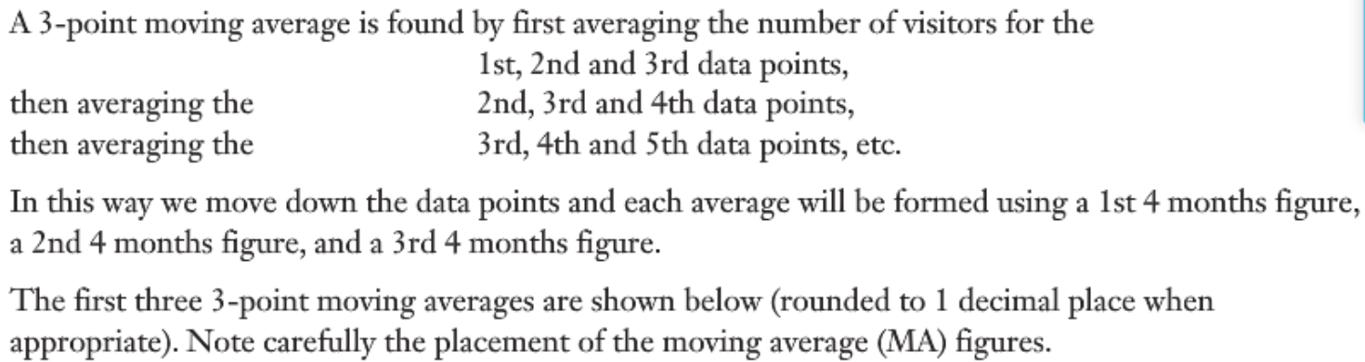
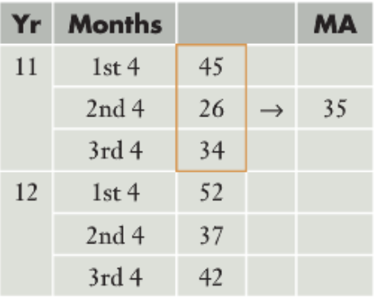
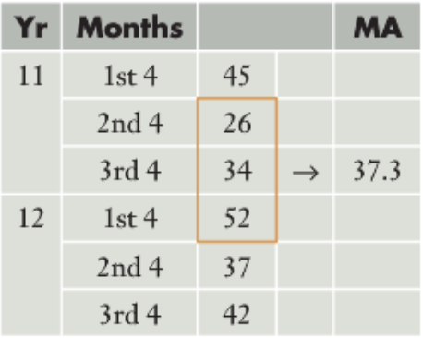
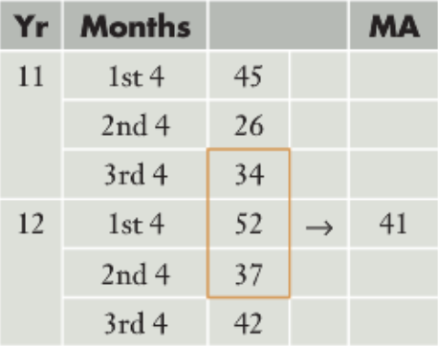
Topic: Moving Averages
EQ: What is a moving average and why do we use them?
For this data, we are going to use a three-point moving average, as there are 3 seasons. If the original data had a four-point pattern, we’d use a four-point moving average. What moving average you use depends on the number of seasons in the cycle.

Slide 24
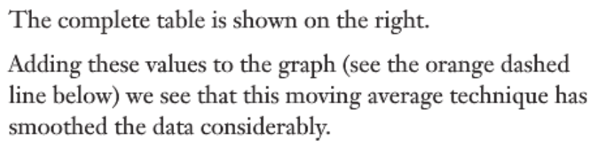
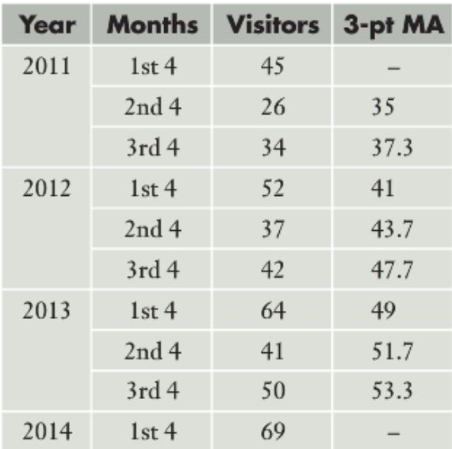
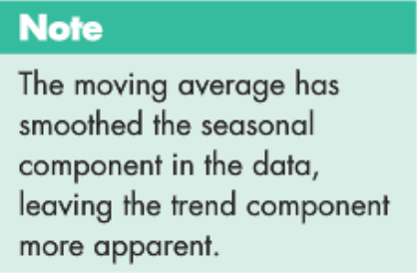
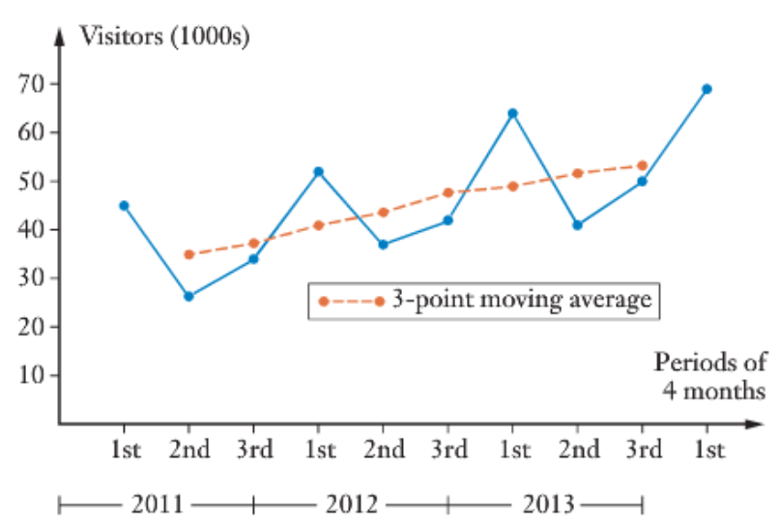
Topic: Moving Averages
EQ: What is a moving average and why do we use them?

Slide 25
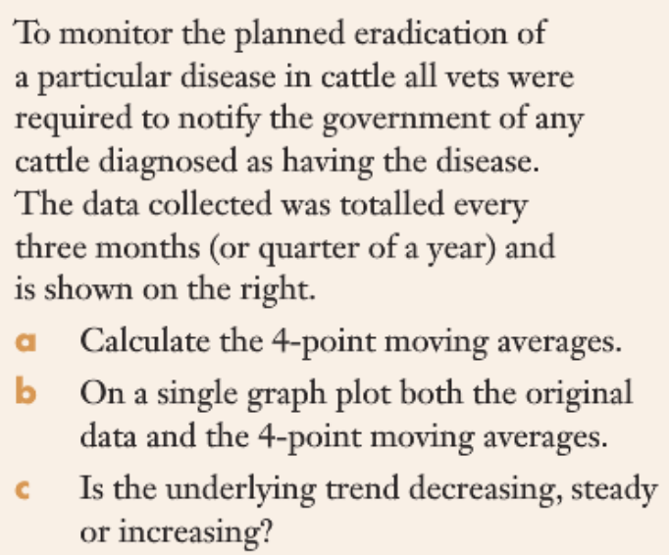
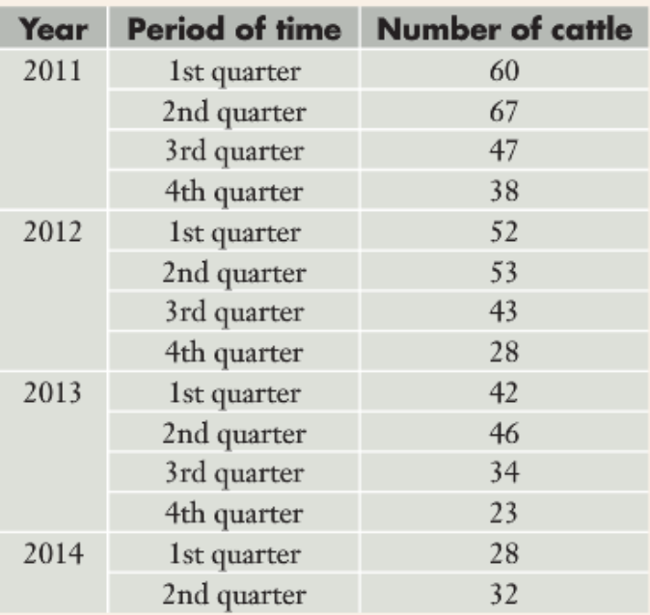
Topic: Moving Averages
EQ: What is a moving average and why do we use them?

Slide 26
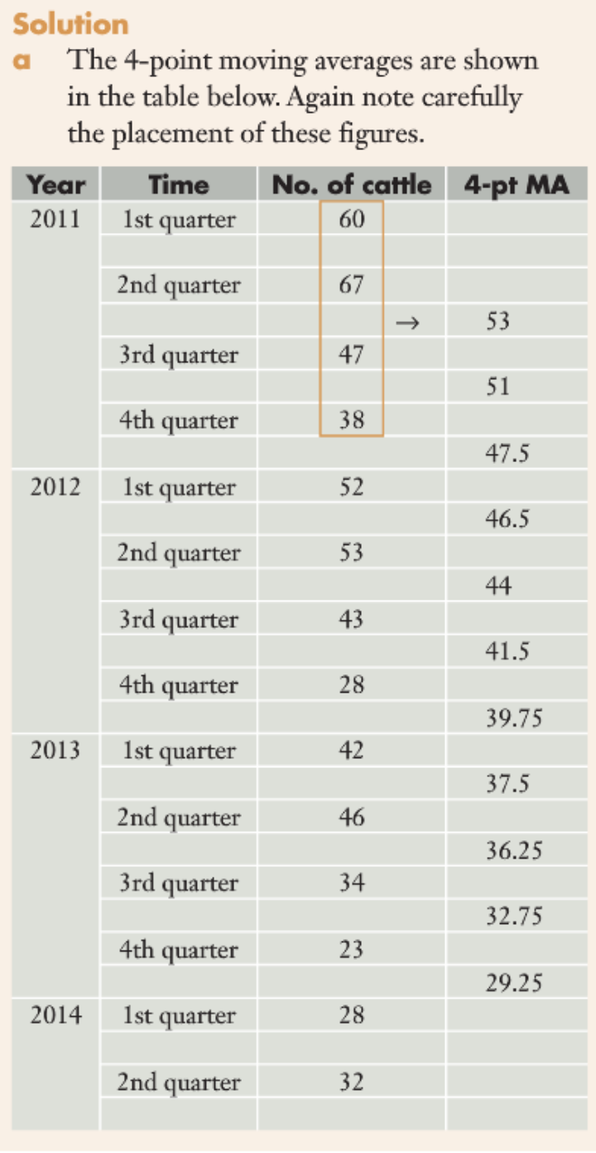
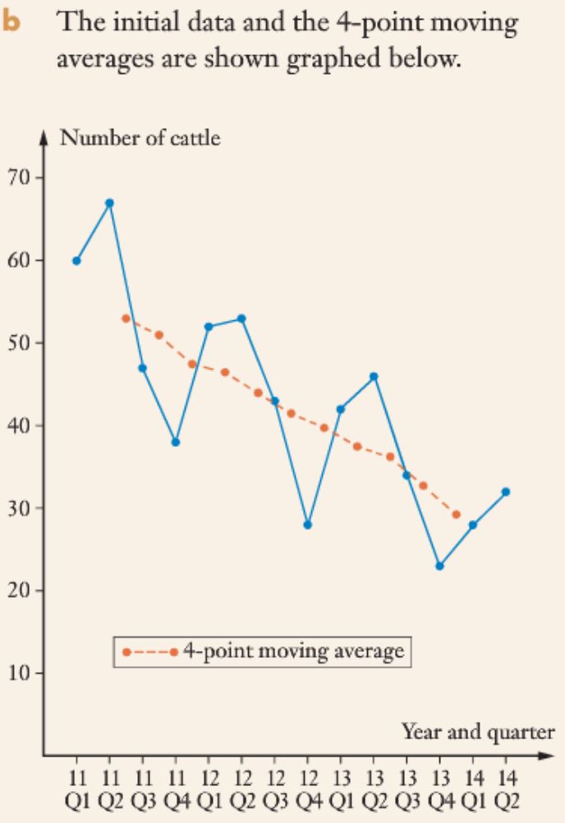
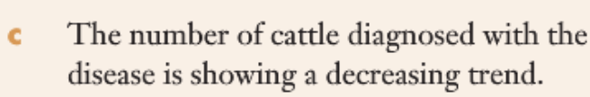
Topic: Moving Averages
EQ: What is a moving average and why do we use them?

Slide 27
Topic: Moving Averages EQ: How do I use the classpad to calculate moving averages?
On the menu open Statistics
In List 1 input the time (or number each data point starting at 1)
In List 2 input your data
Go back to the menu, swipe across onto the second page and open Program
In the “Name:” drop box select TimeSII
On the tool bar at the top press the play button
Press okay, press 1 for moving averages and okay, enter the number of data points per season and okay, leave blank and okay
Press the green play button in the bottom right corner
Forecast: if you want to make a prediction you would type in the time you want a prediction for and then press okay. If you do not want to make a prediction leave it blank and press okay.
Go back to the menu and reopen Statistics
In List 3 you will now be able to see your calculated moving averages

Slide 28
Topic: Moving Averages
EQ: What is a moving average and why do we use them?
Complete Exercise 2A

Slide 29
Lesson 4
Back to Contents
Topic: Centered Moving Averages
EQ: What are centered moving averages and when do I need to calculate them?
Syllabus points:
4.1.3 smooth time series data by using a simple moving average, including the use of spreadsheets to implement this process

Slide 30
Topic: Centred Moving Averages
EQ: What are centred moving averages and when do I need to calculate them?
Year | Period of Time | Number of Pigs | 4 pt. MA
1 | 1st Quarter | 29
 | 2nd Quarter | 31
 |  |  | 26.5
 | 3rd Quarter | 21
 |  |  | 26.25
 | 4th Quarter | 25
 |  |  | 24.5
2 | 1st Quarter | 28
When moving averages are calculated using an even number of data points the new data points don’t sit directly onto the given table ← as seen on the table
To make graphing and analysing the data easier we need to re-align the data such that it sits in the table. We achieve this through centred moving averages.

Slide 31
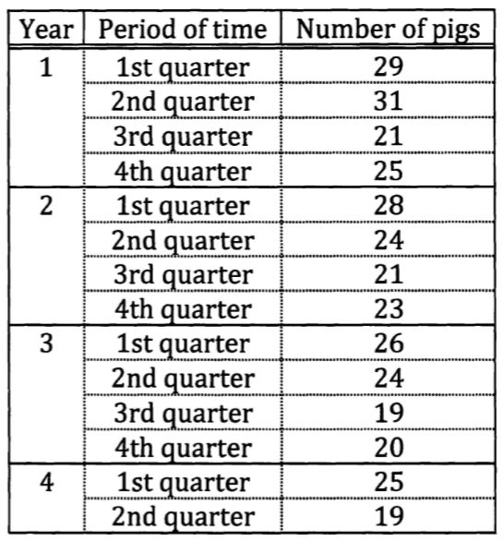
Topic: Centred Moving Averages
EQ: What are centred moving averages and when do I need to calculate them?
Year | Period of Time | Number of Pigs | 4 pt. MA
1 | 1st Quarter | 29
 | 2nd Quarter | 31
 |  |  | 26.5
 | 3rd Quarter | 21
 |  |  | 26.25
 | 4th Quarter | 25
 |  |  | 24.5
2 | 1st Quarter | 28

Slide 32
Topic: Centred Moving Averages
EQ: What are centred moving averages and when do I need to calculate them?
Year | Period of Time | Number of Pigs | 4 pt. MA | Centred 4 pt. MA
1 | 1st Quarter | 29
 | 2nd Quarter | 31
 |  |  | 26.5
 | 3rd Quarter | 21
 |  |  | 26.25
 | 4th Quarter | 25
 |  |  | 24.5
2 | 1st Quarter | 28

Slide 33
Topic: Centred Moving Averages
EQ: What are centred moving averages and when do I need to calculate them?
Year | Period of Time | Number of Pigs | 4 pt. MA | Centred 4 pt. MA
1 | 1st Quarter | 29
 | 2nd Quarter | 31
 |  |  | 26.5
 | 3rd Quarter | 21 |  | 26.375
 |  |  | 26.25
 | 4th Quarter | 25
 |  |  | 24.5
2 | 1st Quarter | 28

Slide 34
Topic: Centred Moving Averages
EQ: What are centred moving averages and when do I need to calculate them?
Year | Period of Time | Number of Pigs | 4 pt. MA | Centred 4 pt. MA
1 | 1st Quarter | 29
 | 2nd Quarter | 31
 |  |  | 26.5
 | 3rd Quarter | 21 |  | 26.375
 |  |  | 26.25
 | 4th Quarter | 25 |  | 25.375
 |  |  | 24.5
2 | 1st Quarter | 28

Slide 35
Complete Exercise 2B

Slide 36
Lesson 5
Back to Contents
Topic: Quantifying the seasonal effect
EQ: How do I calculate seasonal indices?
Syllabus points:
4.1.4 calculate seasonal indices by using the average percentage method concise manner

Slide 37
Topic: Quantifying the Seasonal Effect EQ: How do I calculate seasonal indices?
Seasonal index can also be referred to as the seasonal effect or the seasonal component.
The seasonal index is calculated so that we can clearly see what effect the season has on the data

Slide 38
Topic: Quantifying the Seasonal Effect EQ: How do I calculate seasonal indices?
Step 1:
Find the average for each season.
Year | Time Period | Visitors (thousands)
2011 | 1st 4 months | 45
 | 2nd 4 months | 26
 | 3rd 4 months | 34
2012 | 1st 4 months | 52
 | 2nd 4 months | 37
 | 3rd 4 months | 42
2013 | 1st 4 months | 64
 | 2nd 4 months | 41
 | 3rd 4 months | 50

Slide 39
Topic: Quantifying the Seasonal Effect EQ: How do I calculate seasonal indices?
Step 1:
Find the average for each season.
Year | Time Period | Visitors (thousands) | Mean for the year
2011 | 1st 4 months | 45
 | 2nd 4 months | 26
 | 3rd 4 months | 34
2012 | 1st 4 months | 52
 | 2nd 4 months | 37
 | 3rd 4 months | 42
2013 | 1st 4 months | 64
 | 2nd 4 months | 41
 | 3rd 4 months | 50

Slide 40
Topic: Quantifying the Seasonal Effect EQ: How do I calculate seasonal indices?
Step 1:
Find the average for each season.
Year | Time Period | Visitors (thousands) | Mean for the year
2011 | 1st 4 months | 45 | 35
 | 2nd 4 months | 26
 | 3rd 4 months | 34
2012 | 1st 4 months | 52 | 43.667
 | 2nd 4 months | 37
 | 3rd 4 months | 42
2013 | 1st 4 months | 64 | 51.667
 | 2nd 4 months | 41
 | 3rd 4 months | 50

Slide 41
Topic: Quantifying the Seasonal Effect EQ: How do I calculate seasonal indices?
Step 2:
Find what percentage of the average each data point is.
Year | Time Period | Visitors (thousands) | Mean for the year
2011 | 1st 4 months | 45 | 35
 | 2nd 4 months | 26
 | 3rd 4 months | 34
2012 | 1st 4 months | 52 | 43.667
 | 2nd 4 months | 37
 | 3rd 4 months | 42
2013 | 1st 4 months | 64 | 51.667
 | 2nd 4 months | 41
 | 3rd 4 months | 50

Slide 42
Topic: Quantifying the Seasonal Effect EQ: How do I calculate seasonal indices?
Step 2:
Find what percentage of the average each data point is.
Year | Time Period | Visitors (thousands) | Mean for the year | % of 4 month average
2011 | 1st 4 months | 45 | 35
 | 2nd 4 months | 26
 | 3rd 4 months | 34
2012 | 1st 4 months | 52 | 43.667
 | 2nd 4 months | 37
 | 3rd 4 months | 42
2013 | 1st 4 months | 64 | 51.667
 | 2nd 4 months | 41
 | 3rd 4 months | 50

Slide 43
Topic: Quantifying the Seasonal Effect EQ: How do I calculate seasonal indices?
Step 2:
Find what percentage of the average each data point is.
Year | Time Period | Visitors (thousands) | Mean for the year | % of 4 month average
2011 | 1st 4 months | 45 | 35 | 45/35
 | 2nd 4 months | 26 |  | 26/35
 | 3rd 4 months | 34 |  | 34/35
2012 | 1st 4 months | 52 | 43.667 | 52/43.667
 | 2nd 4 months | 37 |  | 37/43.667
 | 3rd 4 months | 42 |  | 42/43.667
2013 | 1st 4 months | 64 | 51.667 | 64/51.667
 | 2nd 4 months | 41 |  | 41/51.667
 | 3rd 4 months | 50 |  | 50/51.667

Slide 44
Topic: Quantifying the Seasonal Effect EQ: How do I calculate seasonal indices?
Step 2:
Find what percentage of the average each data point is.
Year | Time Period | Visitors (thousands) | Mean for the year | % of 4 month average
2011 | 1st 4 months | 45 | 35 | 128.57%
 | 2nd 4 months | 26 |  | 74.29%
 | 3rd 4 months | 34 |  | 97.14%
2012 | 1st 4 months | 52 | 43.667 | 119.08%
 | 2nd 4 months | 37 |  | 84.73%
 | 3rd 4 months | 42 |  | 96.18%
2013 | 1st 4 months | 64 | 51.667 | 123.87%
 | 2nd 4 months | 41 |  | 79.35%
 | 3rd 4 months | 50 |  | 96.77%

Slide 45
Topic: Quantifying the Seasonal Effect EQ: How do I calculate seasonal indices?
Step 3:
Present the seasonal indices data in a two-way-table.
 | 1st 4 months | 2nd 4 months | 3rd 4 months
2011 | 128.57% | 74.29% | 97.14%
2012 | 119.08% | 84.73% | 96.18%
2013 | 123.87% | 79.35% | 96.77%

Slide 46
Topic: Quantifying the Seasonal Effect EQ: How do I calculate seasonal indices?
Step 4:
Determine the seasonal index by averaging all the % of within each season ↓
 | 1st 4 months | 2nd 4 months | 3rd 4 months
2011 | 128.57% | 74.29% | 97.14%
2012 | 119.08% | 84.73% | 96.18%
2013 | 123.87% | 79.35% | 96.77%
Seasonal Index | 124% | 79% | 97%

Slide 47
Topic: Seasonal Indices EQ: How do I use the classpad to calculate Seasonal Indices?
On the menu open Statistics
In List 1 input the time (or number each data point starting at 1)
In List 2 input your data
Go back to the menu, swipe across onto the second page and open Program
In the “Name:” drop box select TimeSII
On the tool bar at the top press the play button
Press okay, press 3 for SeasInd and okay, press 1 for mean and okay, enter the number of data points per season and okay, leave blank and okay
Press the green play button in the bottom right corner
Forecast: if you want to make a prediction you would type in the time you want a prediction for and then press okay. If you do not want to make a prediction leave it blank and press okay.
Go back to the menu and reopen Statistics
In List 4 you will now be able to see your calculated Seasonal Index for each data point

Slide 48
For more classpad help use the following URLs
http://www.classpad.com.au/cp2/index.php?me=BA4&mn=991&mt=Computer_To_ClassPad_Data_Transfer&my=qkSpVaZHMlw
http://www.classpad.com.au/cp2/index.php?me=BA4&mn=945

Slide 49
Complete exercise 2C please
Back to Contents

Slide 50
Lesson 6
Back to Contents
Topic: Deseasonalising Data
EQ: How do I deseasonalise data?
Syllabus points:
4.1.5 deseasonalise a time series by using a seasonal index, including the use of spreadsheets to implement this process

Slide 51
Topic: Deseasonalising Data EQ: How do I deseasonalise data?
By calculating the seasonal indices we can clearly see what effect the season has on the data. The next step is to use this information to remove the seasonal effect.

Slide 52
Topic: Deseasonalising Data EQ: How do I deseasonalise data?
Step 1:
Determine the seasonal index for each season.
 | 1st 4 months | 2nd 4 months | 3rd 4 months
2011 | 128.57% | 74.29% | 97.14%
2012 | 119.08% | 84.73% | 96.18%
2013 | 123.87% | 79.35% | 96.77%

Slide 53
Topic: Deseasonalising Data EQ: How do I deseasonalise data?
Step 1:
Determine the seasonal index by averaging all the % of within each season ↓
 | 1st 4 months | 2nd 4 months | 3rd 4 months
2011 | 128.57% | 74.29% | 97.14%
2012 | 119.08% | 84.73% | 96.18%
2013 | 123.87% | 79.35% | 96.77%
Seasonal Index | 124% | 79% | 97%

Slide 54
Topic: Deseasonalising Data EQ: How do I deseasonalise data?
Step 2:
In the first four months of 2011 the data shows that the seasonal effect is a 24% increase. In order to deseasonalise the data we need to divide the raw data by the seasonal index:
Year | Time Period | Visitors (thousands) | Mean for the year | % of 4 month average | Deseasonalised data
2011 | 1st 4 months | 45 | 35 | 128.57%
 | 2nd 4 months | 26 |  | 74.29%
 | 3rd 4 months | 34 |  | 97.14%
2012 | 1st 4 months | 52 | 43.667 | 119.08%
 | 2nd 4 months | 37 |  | 84.73%
 | 3rd 4 months | 42 |  | 96.18%
2013 | 1st 4 months | 64 | 51.667 | 123.87%
 | 2nd 4 months | 41 |  | 79.35%
 | 3rd 4 months | 50 |  | 96.77%

Slide 55
Topic: Deseasonalising Data EQ: How do I deseasonalise data?
Step 2:
In the first four months of 2011 the data shows that the seasonal effect is a 24% increase. In order to deseasonalise the data we need to divide by the seasonal index for that point:
Year | Time Period | Visitors (thousands) | Mean for the year | % of 4 month average | Deseasonalised data
2011 | 1st 4 months | 45 | 35 | 128.57% | 45 ÷ 1.24
 | 2nd 4 months | 26 |  | 74.29% | 26 ÷ 0.79
 | 3rd 4 months | 34 |  | 97.14% | 34 ÷ 0.97
2012 | 1st 4 months | 52 | 43.667 | 119.08% | 52 ÷ 1.24
 | 2nd 4 months | 37 |  | 84.73% | 37 ÷ 0.79
 | 3rd 4 months | 42 |  | 96.18% | 42 ÷ 0.97
2013 | 1st 4 months | 64 | 51.667 | 123.87% | 64 ÷ 1.24
 | 2nd 4 months | 41 |  | 79.35% | 41 ÷ 0.79
 | 3rd 4 months | 50 |  | 96.77% | 50 ÷ 0.97

Slide 56
Topic: Deseasonalising Data EQ: How do I deseasonalise data?
In the first four months of 2011 the data shows a seasonal effect of 28.57% increase. In order to deseasonalise the data we need to divide by the seasonal index for that season:
Year | Time Period | Visitors (thousands) | Mean for the year | % of 4 month average | Deseasonalised data
2011 | 1st 4 months | 45 | 35 | 128.57% | 36
 | 2nd 4 months | 26 |  | 74.29% | 33
 | 3rd 4 months | 34 |  | 97.14% | 35
2012 | 1st 4 months | 52 | 43.667 | 119.08% | 42
 | 2nd 4 months | 37 |  | 84.73% | 47
 | 3rd 4 months | 42 |  | 96.18% | 43
2013 | 1st 4 months | 64 | 51.667 | 123.87% | 52
 | 2nd 4 months | 41 |  | 79.35% | 52
 | 3rd 4 months | 50 |  | 96.77% | 56

Slide 57
Topic: Deseasonalising Data EQ: How do I deseasonalise data?
Making predictions:
Now that we have the deseasonalised data we can use linear regression to determine a line of best fit.
However any prediction made using the equation for the line of best fit we be a deseasonalised value. For these predictions to be “real-life values” we need to factor back in the seasonal effect.
Eg:
The predicted value for the 10th data point = 2.167(10) + 35.5 = 57.17
The 10th point would be in the 1st season with a seasonal index of 124%
57.17 x 1.24 = 70.89
Predicted value x seasonal index = Real prediction
Point | Deseasonalised data
1 | 36
2 | 33
3 | 35
4 | 42
5 | 47
6 | 43
7 | 52
8 | 52
9 | 56
10 | ?

Slide 58
Complete exercise 2D please

Slide 59
Extra Work: Please complete the following
KLUP Unit 4 Chapter 1 Review Exercise

Slide 60
Congratulations on finishing Time Series notes
Make sure you are using your WACE study guide for exam style question practice.

